Slide 1
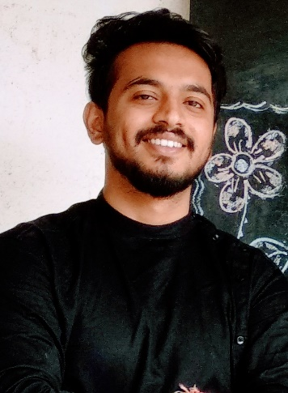



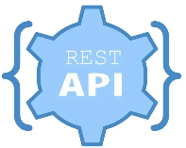
Akash Petkar
Professional Experience: Java, Webservices, MySQL
Responsibilities Handling Capacity
2+ years of experience in the IT industry with Back-end and development experience along with Java . Experience in Spring, Spring MVC, Hibernate, Spring boot, GIT repository, RDMS tools like MySQL.
Experience in building J2ee stack.
Having the knowledge in Web services protocols like REST and experience in developing HTTP using Spring framework.
Experience developing Enterprise applications using Java/J2EE, Spring, Spring Boot, Hibernate, JPA, JSON, XML Schema, Web Services, Maven.
Experience in understanding Application functionality and proposing required SDLC steps.
Well-versed in architecting Webservices on a variety of platforms that includes Java, Spring Boot
Working closely with other developers.
Key Technical and Professional Expertise
Good exposure in designing and implementing projects with a good eye for understanding and tuning performance.
Worked on tools such as Postman, ARC for API testing.
Worked based on Agile technology.
Willing to take additional responsibilities to understand on-premise/legacy system.
Experience in debugging
Other Technical and Professional Expertise
Experience with development and pair programming
Propose with new ideas to improve the code standards and quality.
Good co-ordination skill along with team effort and willing to understand opinions from team.
Ambitious individual who can work under their own direction towards agreed targets/goals and with creative approach to work

